Slide 1

Restaurant Recommendation System
Vaishnavi Sonawane(22106125)
Disha Suryawanshi(22106112)
Mohit Suthar(22106056)
Aman Thakur(22106014)
Project Guide
Prof. Ranjita Asati

Slide 2
Outline
Introduction
Objective
Literature Survey
Limitations
Problem statement
System Design
Technologies and methodologies
Implementation
Conclusion
References

Slide 3
Introduction
Choosing a restaurant for a meal out can be a challenge, especially with the rise of online platforms that either lack efficient recommendations or are cluttered with paid advertisements.
Hence, our project aims to create a restaurant recommendation system that offers trustworthy suggestions, helping users confidently choose a restaurant that suits their tastes.
Restaurant recommendation system suggests eateries based on their attributes like cuisine and location, matching user preferences for personalized dining choices.
The system uses smart math to learn what you like and suggests restaurants that you'll enjoy.

Slide 4
Our system lets you choose between dining in or ordering online, asks location for nearby suggestions, and what type of food you're craving, so it can suggest the perfect spot for you to eat.
A recommendation system is a set of algorithms that learns from the input and checks the data available in the recommendation system, processes and recommends the needful to the users precisely.
Our system has data of more than 1lakh restaurants of metropolitan cities.
Our restaurant recommendation system is designed to satisfy your cravings by suggesting the best, customized dining locations tailored to your preferences.

Slide 5
Objective
To build a restaurant recommendation system that provides personalized restaurant recommendations to users.
To provide efficient restaurant recommendations by considering user inputs on location, cuisine preference, and dining method, ensuring customized suggestions that meet individual preferences.
To provide recommendations for both individuals and groups, recognizing dining as a social activity.

Slide 6
Literature Survey of the existing system
[1] T. V. Yadalam et.al(2020) examines recommendation system methodologies. While hybrid systems are believed to be more effective, this remains unproven. Content-based methods address the cold start issue but demand user data security from developers. Additionally, they offer feedback for sentiment analysis, informing the collaborative approach and fostering better communication between the two methods.
[2] V. Rao et.al.(2017) It uses many machine learning algorithms like random forest classifier, support vector machine and multinomial Naïve Bayes classifier. The dataset under consideration was classified using all of the given three algorithms. The output of the paper proved that random forest classifier is the most efficient one.

Slide 7
[3] Y. Wang, L. Li et.al.(2015) The paper centers on the k-means clustering algorithm applied to electricity distribution load. It demonstrates that k-means effectively creates clusters based on load, yielding highly accurate results.
[4] Kim, SW. et.al.(2019) dsicusses the three sentiment analysis approaches: binary analysis, word vectorization with TF-IDF scoring, and next-word negation. The simple TF-IDF model is efficient and accurate.
[5] M. Petrusel et.al.(2019) In this, TF-IDF is used. Six steps: data collection, manual review annotation, pre-processing, representation, classification, sentiment analysis. Output feeds into a recommendation engine, sorting restaurants by reviews and ratings.

Slide 8
Limitations
Unchanging suggestions: Some systems lack real-time updates, leading to outdated recommendations that may not reflect changes in restaurant quality or popularity.
Lack of Personalization: Many recommendation systems fail to offer personalized suggestions tailored to specific user preferences.
Dependency on data : Due to data dependency, our system may primarily recommend restaurants in metropolitan areas.

Slide 9
Problem statement
Choosing a restaurant can be daunting with numerous options available and conventional methods often falling short. Also with the rise of online platforms that either lack efficient recommendations or are cluttered with paid advertisements .
Thus, there's a demand for an efficient, user-friendly recommendation system. Our solution, a content-based filtering restaurant recommendation system, addresses this need by offering personalized suggestions considering individual preferences, dietary needs, and relevant factors.

Slide 10
System Design
In our project we have used Content-based Filtering.
The algorithms we have used are-
TF(Term frequency)
IDF(Inverse document frequency)
Cosine similarity

Slide 11
TF: TF measures how often a term appears in a document relative to the total number of terms in that document, indicating its importance.
IDF: IDF quantifies how rare a term is across all documents by taking the logarithm of the total number of documents divided by the number of documents containing the term.

Slide 12
Cosine Similarity
Cosine similarity is used in content based filtering to measures the cosine of the angle between two vectors, representing the similarity between their directions or orientations in a high-dimensional space.
It aims to recommend restaurants to users by calculating similarity among them based on features like cuisine type, location, and average reviews. The goal is to help users discover new restaurants matching their preferences and location.

Slide 13
Technologies and method.
To make the recommendation easier we have used Machine learning and various algorithms. We have made restaurant recommendation system using content-based filtering.
Content-based filtering:
Content-based filtering suggests items by comparing their attributes to user preferences, prioritizing those closely matching past interactions.
It tailors personalized recommendations by focusing on item characteristics, not user behavior, ensuring relevance to individual tastes.
This method excels in recommending items with specific attributes aligned with the user's interests, enhancing the user experience.

Slide 14
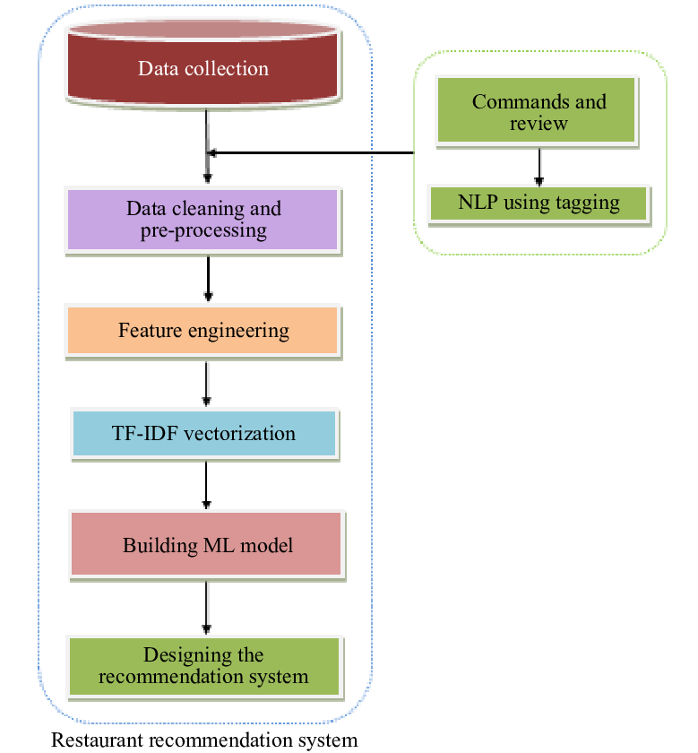
Block Diagram:
Control flow diagram of proposed system

Slide 15
Data collection: The dataset employed for this research work has been fetched from Kaggle.com .Data collection comprises of 2lakhs restaurants of metro cities and Maharashtra.The dataset comprises of columns like URL, name, rate, location, cuisines, online orders, approx._cost(for two people), etc
Data cleaning and pre-processing: It includes removing unnecessary columns, eliminating duplicates, modifying column names, and conducting data transformations for desired format alignment.
Feature engineering: It involves analysing data to understand patterns and relationships, enhancing model performance in statistical modelling or machine learning.

Slide 16
TF-IDF vectorisation: It is a method in NLP to turn text into numerical vectors. It measures how important a word is to a document in a collection, considering both its frequency in the document and across all documents.
Building an ML model : It involves selecting suitable algorithms based on the problem type and data characteristics, training them with training data, optimizing parameters, and evaluating performance using metrics like accuracy or loss.
Designing recommendation system: The hybrid recommendation system combines content-based filtering (CBF). It analyzes user comments to extract preferences and recommends restaurants with similar menus. It also suggests restaurants based on the user's past food choices.

Slide 17
Implementation
For website creation we have used html, css and javascript for new user login and authentication.
Python is the best programming language suited for Machine Learning. According to studies and surveys.
Advantages :- Easy to learn and understand, Multi-purpose language, Support of open source community.
Dataset:- We have used www.kaggle.com open source dataset. Our training dataset is of 2500 but the mein dataset is around 2.5lakhs.
The Main Dataset we have used is ZOMATO.CSV as it has over 50000 data entries in it.
We have also used Jupyter Notebook and Anaconda Prompt.

Slide 18



For Training we have used jupyter notebook and for the project we have used different algorithms like TF,IDF, cosine similarity.
We have used pandas library for using CSV dataset.

Slide 19
Conclusion
We have developed a web application for recommending restaurants based on user preferences, ensuring efficient and personalized suggestions. Our content-based filtering model predicts suitable restaurants, offering ratings for user convenience. This application simplifies restaurant prediction, widely applying popularity-based filtering for effective recommendations.

Slide 20
References
[1] T. V. Yadalam, V. M. Gowda, V. S. Kumar, D. Girish and N. M., "Career Recommendation Systems using Content based Filtering," 2020 5th International Conference on Communication and Electronics Systems (ICCES), COIMBATORE, India, 2020, pp. 660-665, doi: 10.1109/ICCES48766.2020.9137992.
[2] V. Rao and J. Sachdev, "A machine learning approach to classify news articles based on location," 2017 International Conference on Intelligent Sustainable Systems (ICISS), Palladam, 2017, pp. 863-867, doi: 10.1109/ISS1.2017.8389300.
[3] Y. Wang, L. Li and Q. Yang, "Application of clustering technique to electricity customer classification for load forecasting," 2015 IEEE International Conference on Information and Automation, Lijiang, 2015, pp. 1425-1430, doi: 10.1109/ICInfA.2015.7279510.

Slide 21
[4]Kim, SW., Gil, JM. Research paper classification systems based on TF-IDF and LDA schemes. Hum. Cent.Comput.Inf.Sci.9,30(2019). https://doi.org/10.1186/s13673-019-0192-7
[5] M. Petrusel and S. Limboi, "A Restaurants Recommendation System: Improving Rating Predictions Using Sentiment Analysis," 2019 21st International Symposium on Symbolic and Numeric Algorithms for Scientific Computing (SYNASC), Timisoara, Romania, 2019, pp. 190-197, doi: 10.1109/SYNASC49474.2019.00034.

Slide 22
Thank You...!!

